Slide 1
Ride Share

Slide 2
Outline
1.Introduction
2.Features
3.Use Case Diagram
4.Contract details
5.Requirements
6.Usage
7.Conclusion

Slide 3
Introduction
The code is for a smart contract called Rideshare that allows riders to request rides from drivers and drivers to accept rides. It also allows riders to cancel rides and mark rides as completed.

Slide 4
Features
The contract stores the details of rides in a Ride struct, which has the following fields:
*rider: The address of the rider who requested the ride.
*driver: The address of the driver who accepted the ride.
*price: The price that the rider paid for the ride.
*distance: The distance of the ride.
*cashBack: The amount of money that the rider gets back as a cashback for taking the ride.
*isCompleted: A boolean value indicating whether the ride has been completed or not.

Slide 5
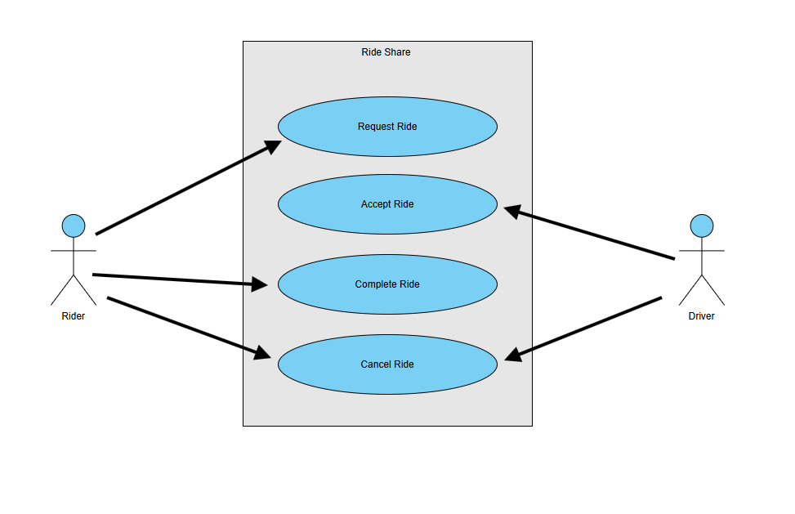
Use Case Diagram

Slide 6
Contract details
- The contract is written in Solidity and targets the `0.8.0` version of the Solidity compiler.
- The contract has a constructor that requires the caller to send at least `.0001 ether` when deploying the contract.
- The contract uses a mapping from ride IDs to `Ride` structs to store the rides. The ride ID is a unique uint256 value that is incremented by 1 for each new ride.
- The contract has an `NewRide` event that is emitted whenever a new ride is requested.

Slide 7
Requirements
- In this project, the smart contract was successfully deployed and tested on the Ethereum Virtual Machine (EVM) using the Remix IDE. Without integrating a Web3 wallet, all functions were executed directly through Remix’s built-in test accounts..

Slide 8
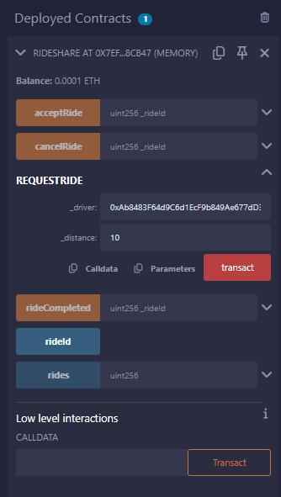
Usage
Request Function

Slide 9
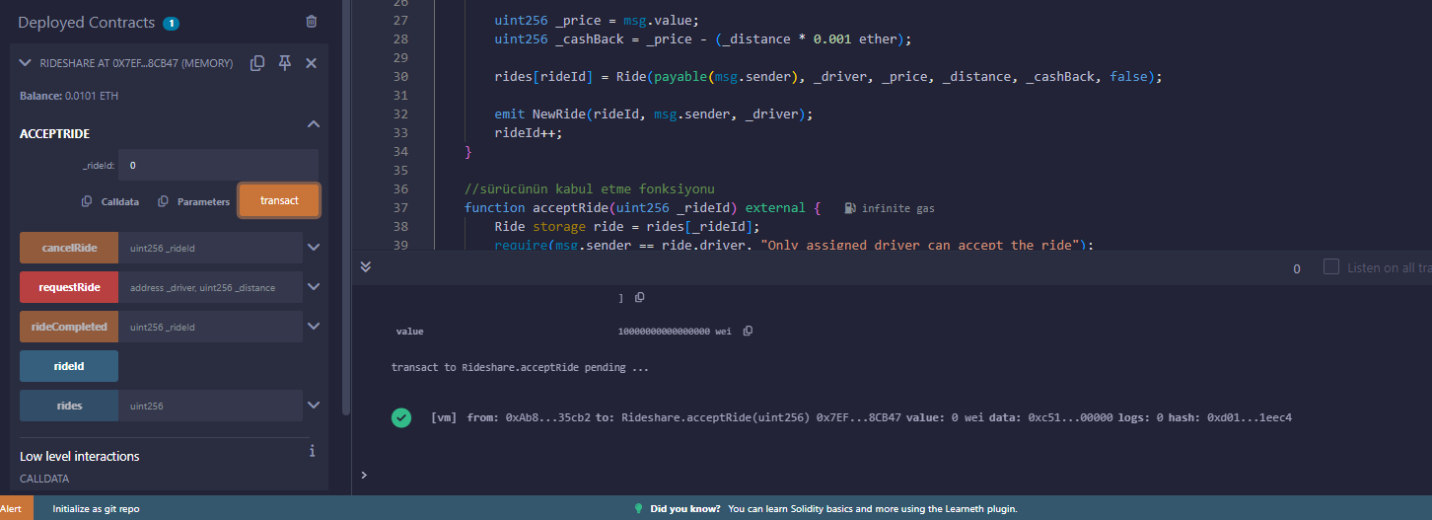
Usage
AcceptRide Function

Slide 10
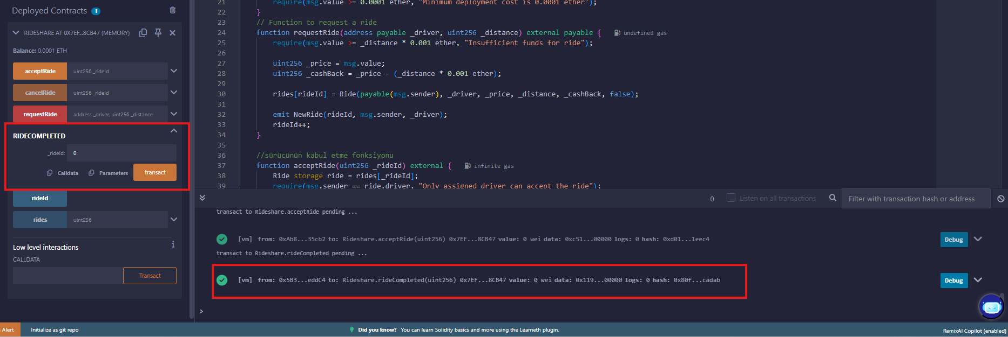
Usage
Ride Completed Function

Slide 11
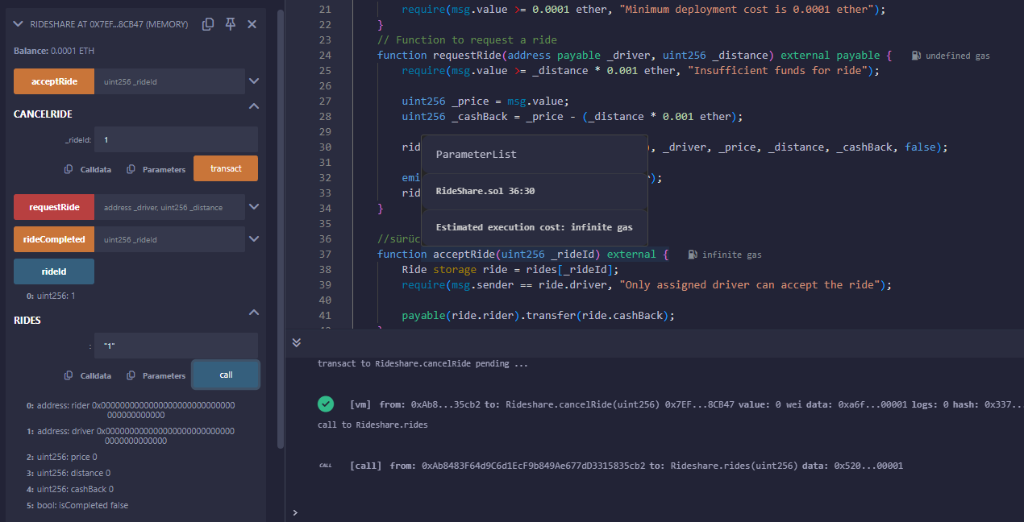
Usage
Cancel Ride Function

Slide 12
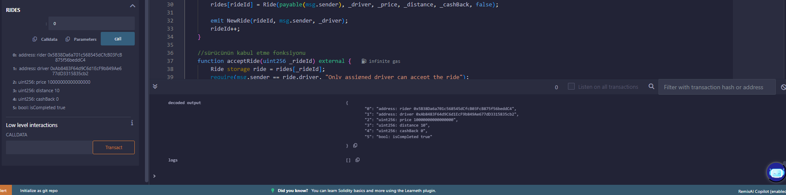
Usage
Rides

Slide 13
Conclusion
I made a smart contract for Ridesharing that works as peer to peer. with the help of wallets and blockchain. An uber
1900004000 – Kadir KARATAŞ

